Slide 1

Pathway analysis
Biostat & Bioinfo short course series
7/25/2016
Jianying Li

Slide 2

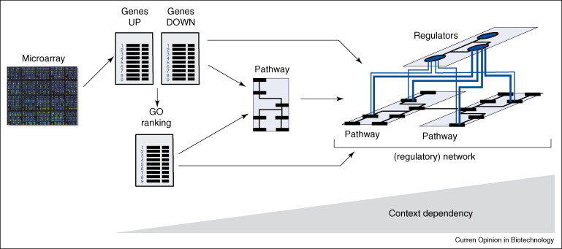
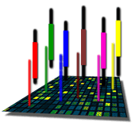
The Road to Pathway Analysis
Next Gen RNA-Seq
Adapted from Werner (2008), Current Opinion in Biotech., 19:50-64
Notes:
2

Slide 3
What are biological pathways??
Definition in Wikipedia:
"... a series of actions among molecules in a cell that leads to a certain product or a change in a cell."
Pathway types:
Metabolic pathway
Ontologies
Gene regulation pathways
Signal transduction pathways
...

Slide 4
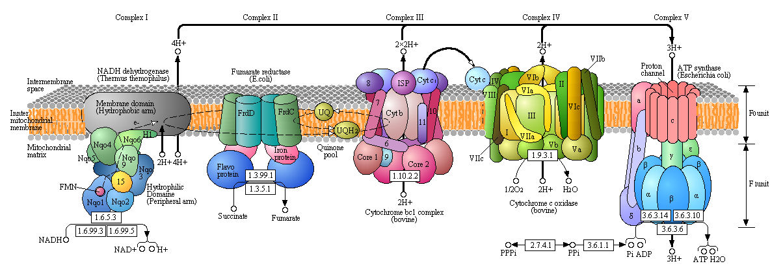
The oxidative phosphorylation
http://employees.csbsju.edu/hjakubowski/classes/ch331/oxphos/olcouplingoxphos.html

Slide 5
Why pathway analysis?
Genes are associated and respond collectively toward perturbation or condition changes
Signal obtained from a collection of genes working together reflects a bigger picture
PA offers apparent advantage over single-gene analysis
Different samples from a common condition may have different key genes that are all driving changes in the same pathway
Pathways may be perturbed by subtle changes in many genes
A small list of enriched pathways may be easier to interpret than a large list of associated genes
Pathways results from different studies may overlap better than single-gene results

Slide 6
Why pathway analysis –cont.?
Modern technologies offer large scale (landscape) measurement
MicroArray gene expression
RNASeq
Other genomics measurement
Well curated knowledgebase and information collection provide rich basis

Slide 7
Well curated knowledgebase
GeneOntology
Molecular function describing activities, such as catalytic or binding activities, at the molecular level
Biological process referring to a biological objective to which the gene product contributes
Cellular component referring to the place in the cell (i.e. the location) where a gene product is found
KEGG pathway
Metabolism: carbohydrates, energy, lipid, nucleotides, amino acid, xenobiotics
Human diseases
Genetic information processing
Transfac/Transpath
Data on transcription factors, their experimentally-proven binding sites, and regulated genes
Protein-protein interactions and directed modification of proteins involved in signal transduction pathways,

Slide 8
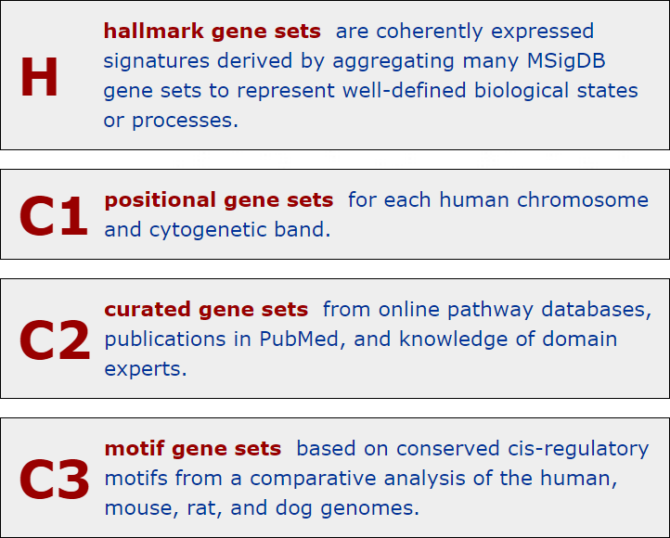
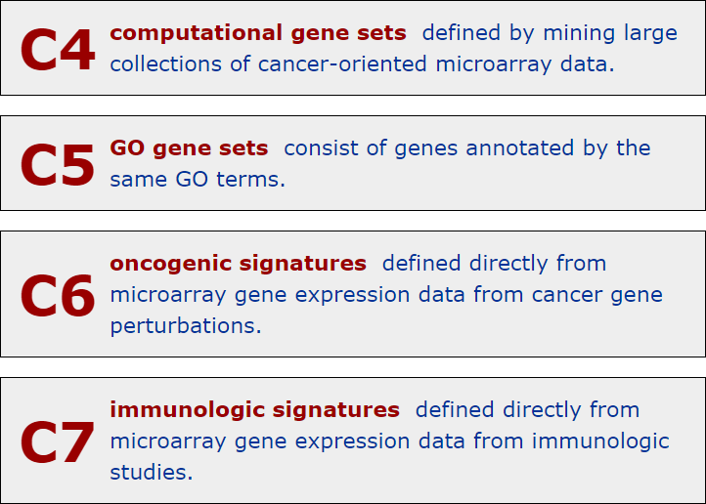
Molecular Signatures Database (MSigDB)
Free database (http://www.broadinstitute.org/gsea/msigdb)

Slide 9
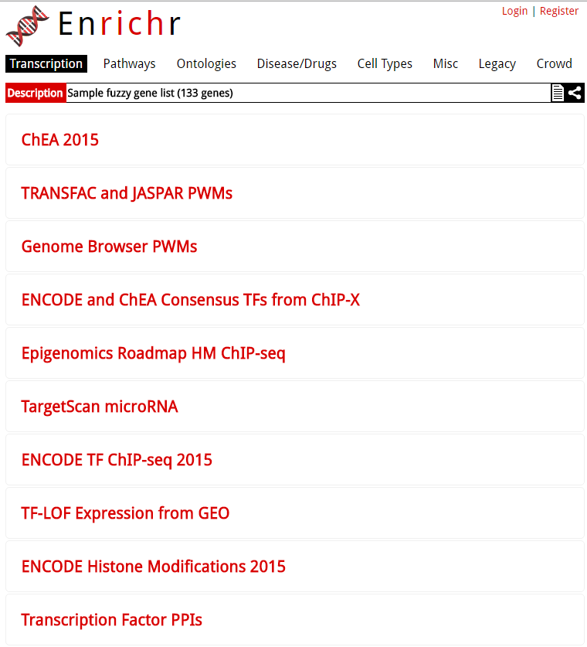
http://amp.pharm.mssm.edu/Enrichr/enrich

Slide 10
Why pathway analysis –cont.?
Well-established statistical and computation algorithms
Parametric method
Hypergeometric test
Fisher’s exact test
Non-parametric approaches
GSEA
GSA
Etc.
Other algorithms
Auto expand : Draws sub-networks around the selected objects
Shortest paths: Uses Dijkstra’s shortest paths algorithm to find the shortest directed paths between the selected objects.
Self regulation :Finds the shortest directed paths containing transcription factors between the selected objects
Etc.

Slide 11
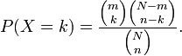
Hypergeometric Test (Right-tailed)
An urn with two types of marbles:
N total # of marbles
Of which, m # of red marbles
Drawing a red marble is a success!
Drawing a white marble is a failure!
n is the # of marbles randomly drawn
k is the # of successes (red marbles) in the sample
Hypergeometric distribution gives the probability
for k = 0,1,2,…,n
k<=m, n-k <=N-m

Slide 12
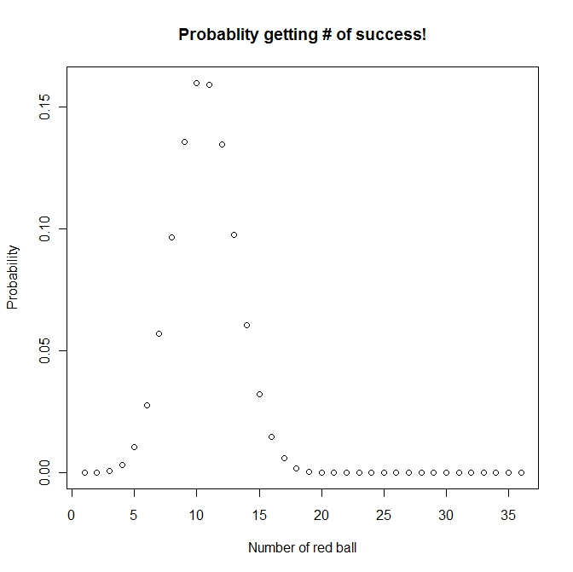
Hypergeometric distribution
m
Number of red ball: 50
Number of white ball: 120
Number of ball drawn (without replacement): 36
Possible number of success ??
(0,1, 2, ….36),
Probability to get 20 red balls is: 0.0001494571
N
n
p(k=20, 36, 50, 170)
http://www.aiaccess.net/English/Glossaries/GlosMod/e_gm_hypergeometric.htm

Slide 13
Pathway analysis (an analogy)
Gene expression analysis results
Total number of gene on a chip: 520
Of which 20 genes are in a GO
Total number of DEG: 40
Of which 5 genes are in GO
total N genes – N, of which m genes belong to a pathway; k genes were identified as differentially expressed, x genes belong to this “pathway”
Do you think it is significant at α=0.01? In other words “is this GO category enriched by/significant this microarray experiment”?
The p-value indicates the probability that the biological process category (particular pathway) is enriched by this microarray experiment by chance. The smaller the p-val, the higher the significance
The answer is simple, which is to perform a hypergeometric test: phyper(4, 20, 500, 40, lower.tail=FALSE) = 0.01371

Slide 14
Fisher’s Exact Test (FET) --right-tailed test
Contingency table
DEG Not DEGs totals
In a GO category x m-x m
Not in GO category k-x n-k+x n
totals k m+n -k m + n (genes on array)
So, now you are probably given something like the following:
x <- 5 #num_of_DEG in GO
m <- 20 #num_of_gene on chip in GO
n <- 500 #num_of_gene on chip NOT in GO
k <- 40 #num_of_DEG
N
Hypergeometric test vs. FET, we shall get same result
phyper((x-1), m, n, k, lower.tail=FALSE)
(fisher.test(matrix(c(x,(k-x), (m-x), (n-k+x)),2,2), alternative='greater'))$p.value

Slide 15
Ingenuity Pathway Analysis (IPA) --Knowledgebase
Desktop Java application utilizing a remote server for data, analysis and file management
IPA Ontology: Curation of the scientific literature and content extraction of the IPA repository of molecular interactions, regulatory events, biological processes, gene-to-phenotype associations, and chemical knowledge

Slide 16
IPA Enrichment Analysis
Uses the Fisher’s exact test to determine the significance of a functional group or pathway
# molecules in a list that are associated with a function/pathway (k)
total # of molecules that are associated with a function/pathway (m)
# of molecules in all possible functions/pathways (N)
# of molecules in a list (n)

Slide 17
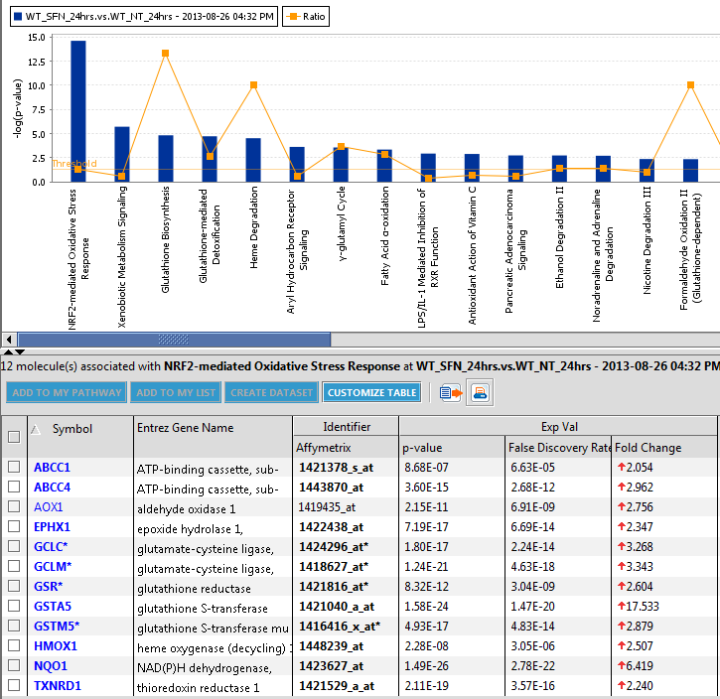
All the DEGs in the pathway are up-regulated
Nrf2-mediated oxidative stress in wild type strain at 24 hours

Slide 18
A non-parametric approach
Based on Kolmogorov-Smirnov (K-S) test
Compare a sample empirical distribution function to the reference distribution
Or, compare two sample empirical distribution functions
Required data:
Ranked list of genes sorted by differential expression (includes all genes)
A gene set
If the genes in the gene set tend to fall near either end of the ranked list, the gene set is considered significantly enriched
The test significance is obtained from empirical distribution
Permutation based
Bootstrapping
Etc.

Slide 19
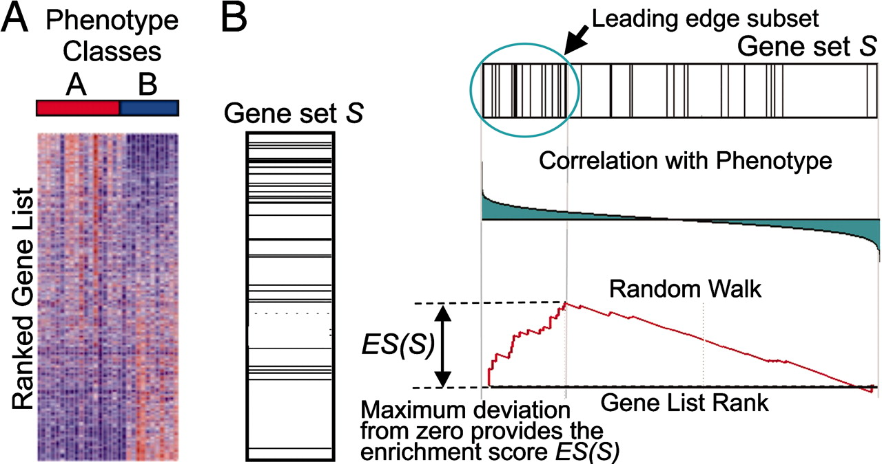
A GSEA overview illustrating the method.
Subramanian A et al. PNAS 2005;102:15545-15550
©2005 by National Academy of Sciences
Notes:
A GSEA overview illustrating the method. (A) An expression data set sorted by correlation with phenotype, the corresponding heat map, and the “gene tags,” i.e., location of genes from a set S within the sorted list. (B) Plot of the running sum for S in the data set, including the location of the maximum enrichment score (ES) and the leading-edge subset.

Slide 20
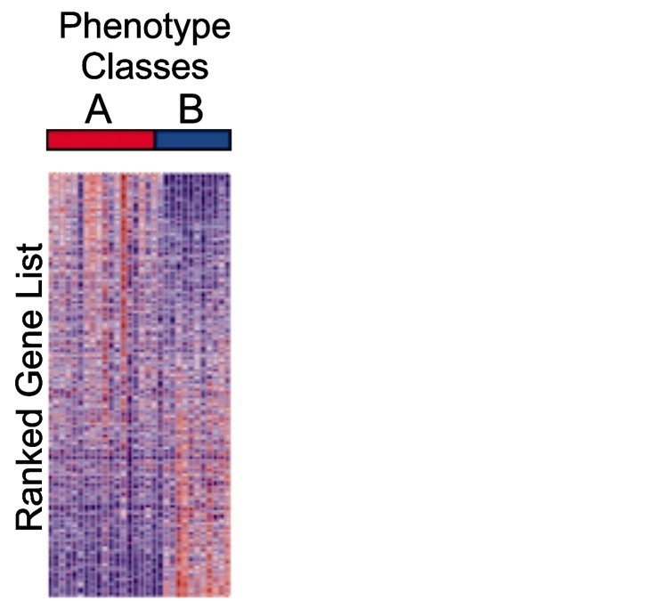
Kolmogorov–Smirnov (KS) Test
(upregulated)
(downregulated)

Slide 21
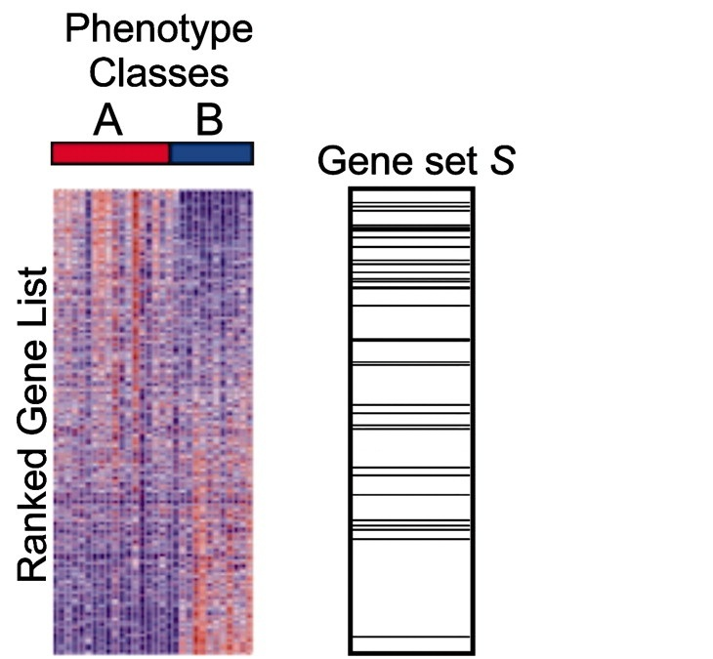
Kolmogorov–Smirnov (KS) Test
(upregulated)
Large, positive enrichment score
(downregulated)

Slide 22
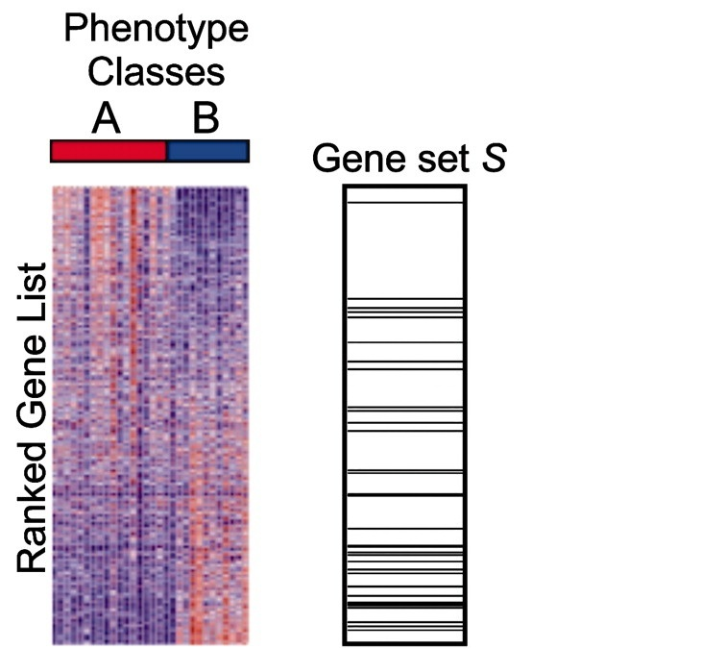
Kolmogorov–Smirnov (KS) Test
(upregulated)
Large, negative enrichment score
(downregulated)

Slide 23
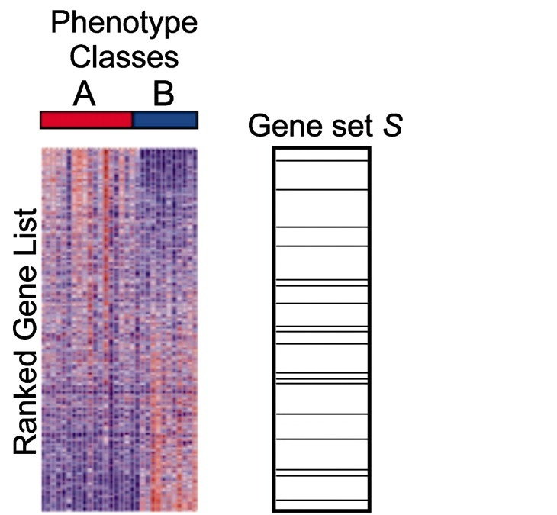
Kolmogorov–Smirnov (KS) Test
(upregulated)
Near zero enrichment score
(downregulated)

Slide 24
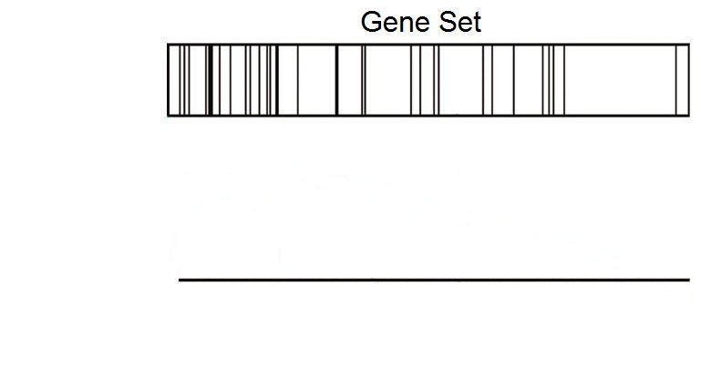
Kolmogorov–Smirnov (KS) Test
(upregulated)
(downregulated)

Slide 25
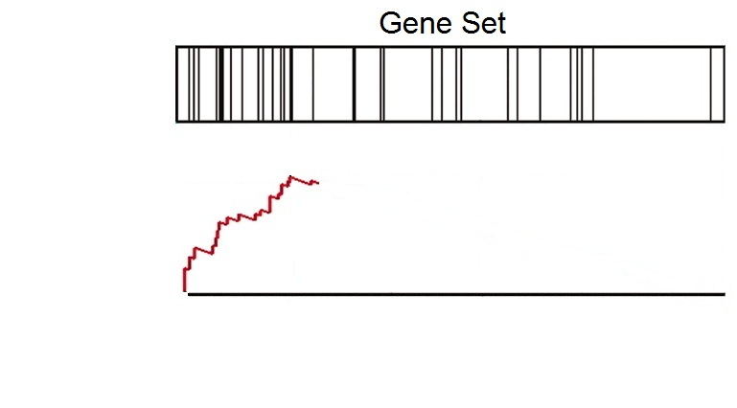
Kolmogorov–Smirnov (KS) Test
(upregulated)
(downregulated)

Slide 26
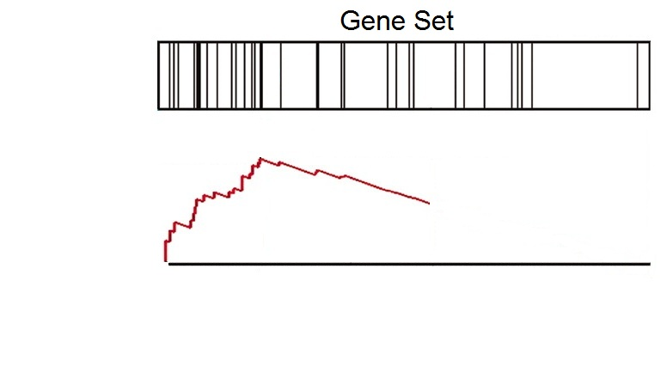
Kolmogorov–Smirnov (KS) Test
(upregulated)
(downregulated)

Slide 27
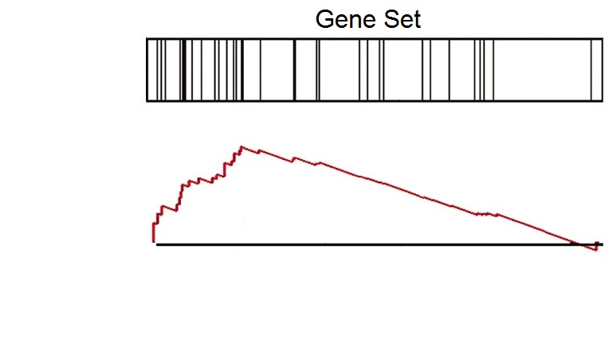
Kolmogorov–Smirnov (KS) Test
(upregulated)
(downregulated)

Slide 28
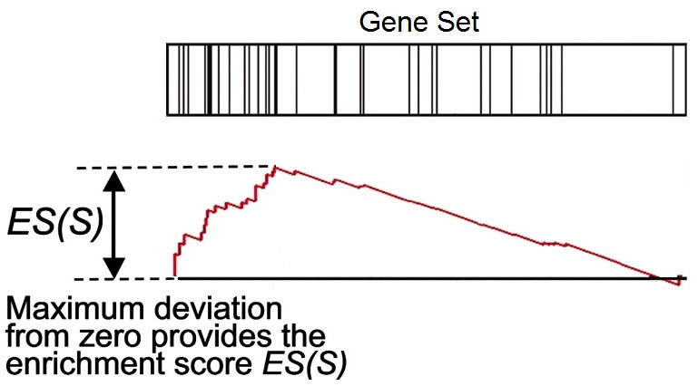
Kolmogorov–Smirnov (KS) Test
(upregulated)
(downregulated)

Slide 29
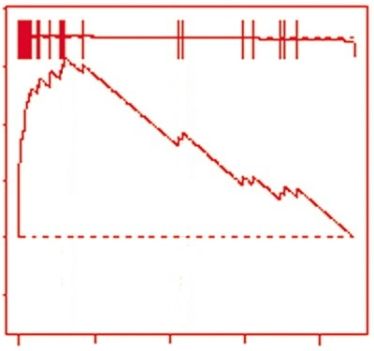
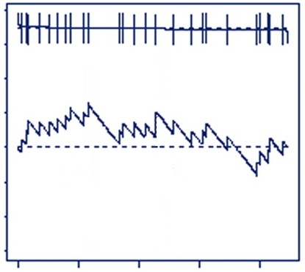
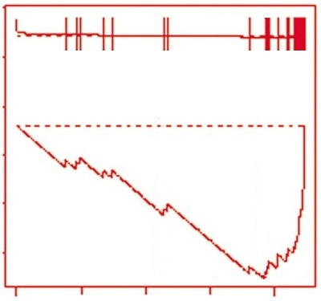
Kolmogorov–Smirnov (KS) Test
Many genes
upregulated
Genes
randomly distributed
Many genes
downregulated
Large positive
enrichment score
Near zero
enrichment score
Large negative
enrichment score

Slide 30
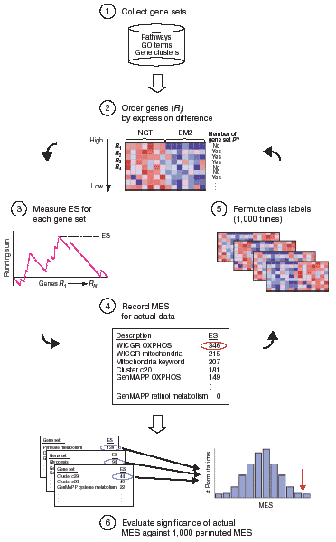
Mootha et al., Nature Genetics, 2003, 34(3):267-273

Slide 31
Additional Processing
Apply a multiple comparison correction (FDR)
Interpret p-values cautiously
Filter out gene sets that are too small or too big
Explore key drivers in significant pathways
Experimentally validate or follow up on significant gene sets

Slide 32
Other Types of Pathway Analysis
Other data types (genotype, copy number, etc.)
Other types of gene lists (genes from proteomics, ChIP targets, etc.)
Custom gene sets (genes of interest, DEGs from another analysis, etc.)

Slide 33
Kolmogorov–Smirnov (KS) Test
Used in Gene Set Enrichment Analysis (GSEA)
Free software (http://www.broadinstitute.org/gsea)
Pros:
Large collection of gene sets
Uses more information than methods that only use DEG list
Enrichment plot improves interpretability
Cons:
Permutation-based p-values

Slide 34
Some caveat in pathway analysis
Concerns with GO based pathway analysis
Ignore GO hierarchy – treat each term independently
Ignore gene (expression) level/rank
Ignore correlation – assuming genes (in a category) are uncorrelated
Sampling over genes (observation)
All these make p values quite unclear
Facts on the non-parametric approach
Pros
Relax on “strong assumption”
Customized gene set is allowed
Cons
Computationally intensive
Some concerns on the statistical power

Slide 35
The universe matters
It is important to choose the universe correctly
Case 1: universe is all genes in the genome
 | DEGs | Non-DEGs | Total
In GO | 10 | 30 | 40
Not in GO | 390 | 3570 | 3960
Total | 400 | 3600 | 4000
p=0.049
Case 2: universe is only expressed genes
 | DEGs | Non-DEGs | Total
In GO | 10 | 30 | 40
Not in GO | 390 | 570 | 960
Total | 400 | 600 | 1000
p=0.0048

Slide 36
Sets are overlapped
A
B
Set B is enriched only because of it overlap with set A

Slide 37
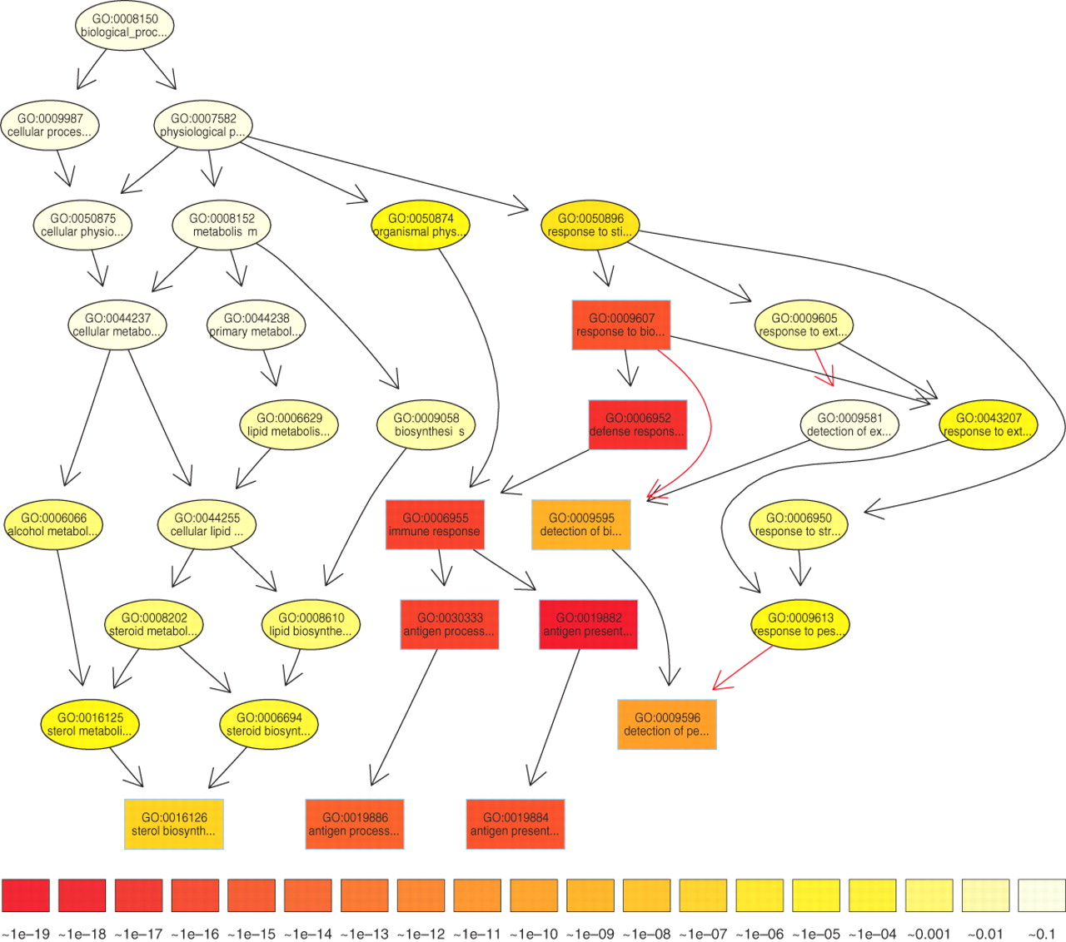

The subgraph induced by the 10 most significant GO terms identified by a current state-of-the-art method for scoring GO terms for enrichment.
TopGO’s elimination algorithm
Test the leaf sets first. If significant,
remove its “genes” before testing its
ancestor sets
TopGO’s weight algorithm
The genes are weighted by their relevance
in the significant nodes.
The enrichment score of a parent (gene
node u) is compared with the scores of
its children.
Children with a better score than u
represent the interesting genes better.
Therefore, their significance is increased
Children with a lower score than u have
their significance reduced.
Alexa A et al. Bioinformatics 2006;22:1600-1607
© The Author 2006. Published by Oxford University Press. All rights reserved. For Permissions, please email: journals.permissions@oxfordjournals.org
Notes:
The subgraph induced by the 10 most significant GO terms identified by a current state-of-the-art method for scoring GO terms for enrichment. Boxes indicate the 10 most significant terms. Box color represents significance, ranging from dark red (most significant) to light yellow (least significant). The numbers in the legend represent the magnitude of the raw p-values associated with the respective color. Black arrows indicate is–a relationships and red arrows part–of relationships.

Slide 38
Now, it is your turn
Hands on practice on both parametric and non-parametric

Slide 39
Click to download

Slide 40
Provide your email

Slide 41

GSEA Example

Slide 42
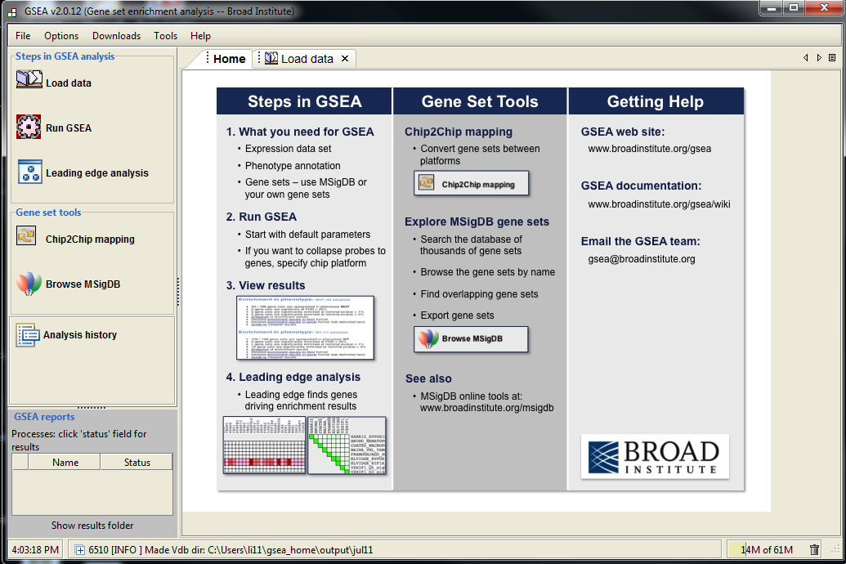
Step 1
Step 2
Step 3

Slide 43
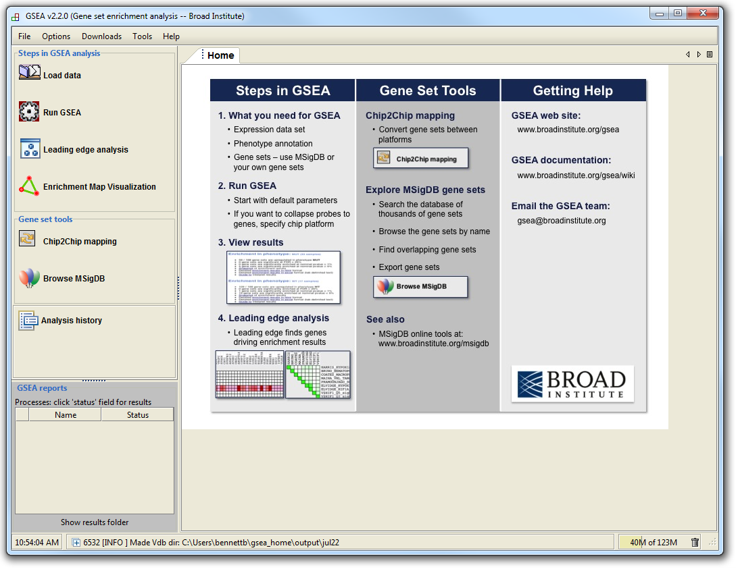
GSEA Example

Slide 44
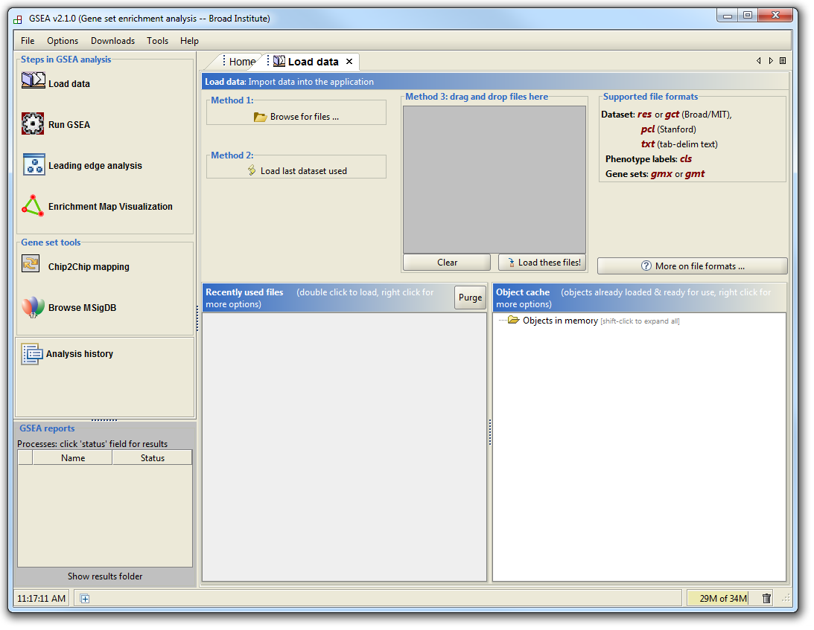
GSEA Example

Slide 45
GSEA Example
Supported file types:
http://www.broadinstitute.org/cancer/software/gsea/wiki/index.php/Data_formats
Required:
Expression data file
Class label file
Optional:
Gene set file

Slide 46
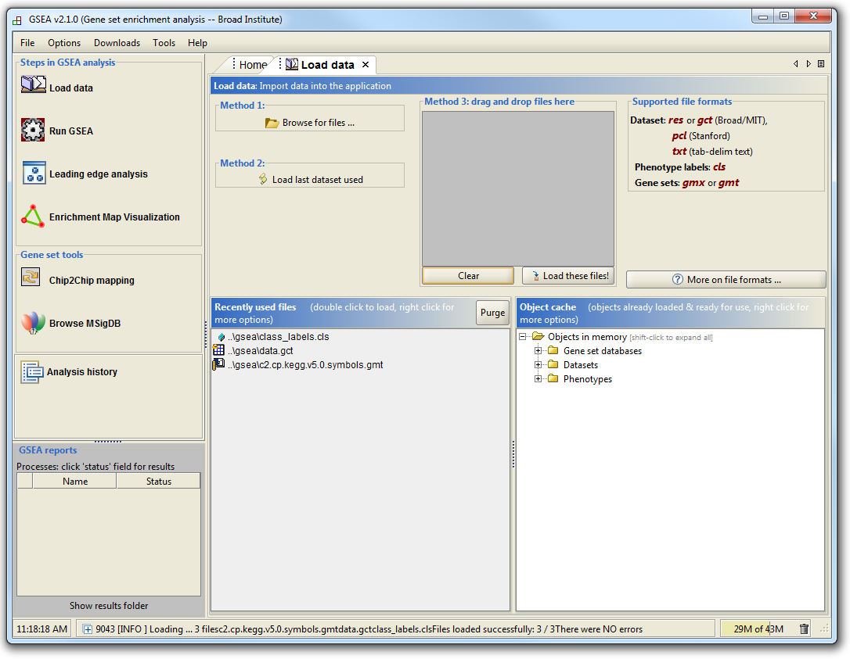
GSEA Example

Slide 47
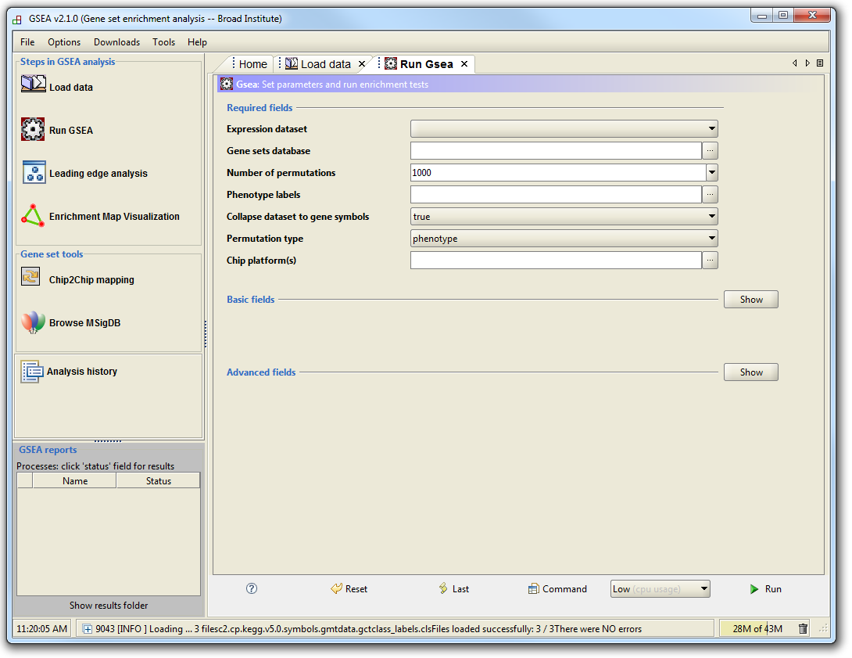
GSEA Example

Slide 48
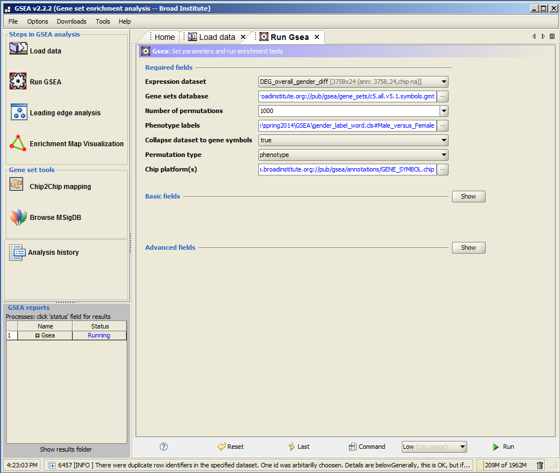

Slide 49
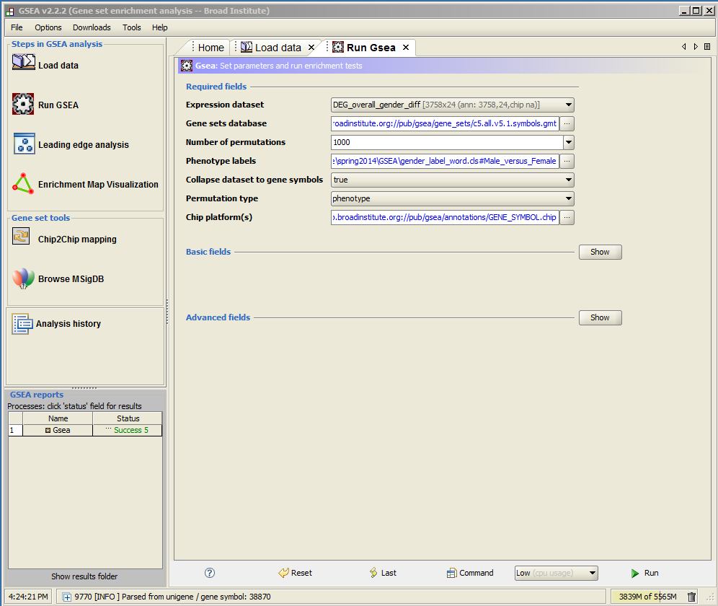
click

Slide 50
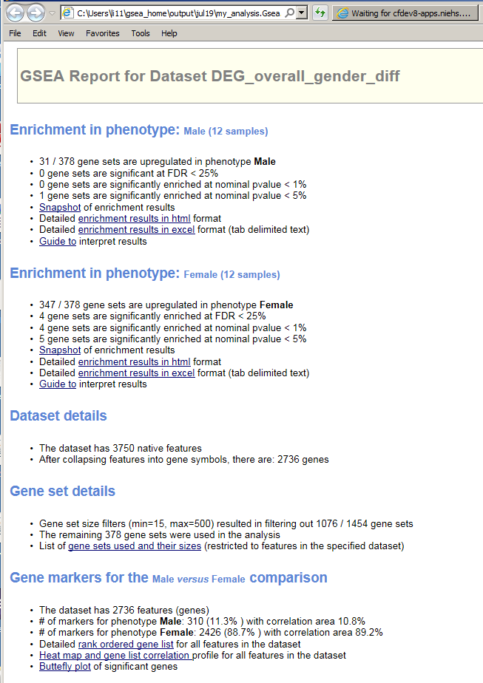

Slide 51
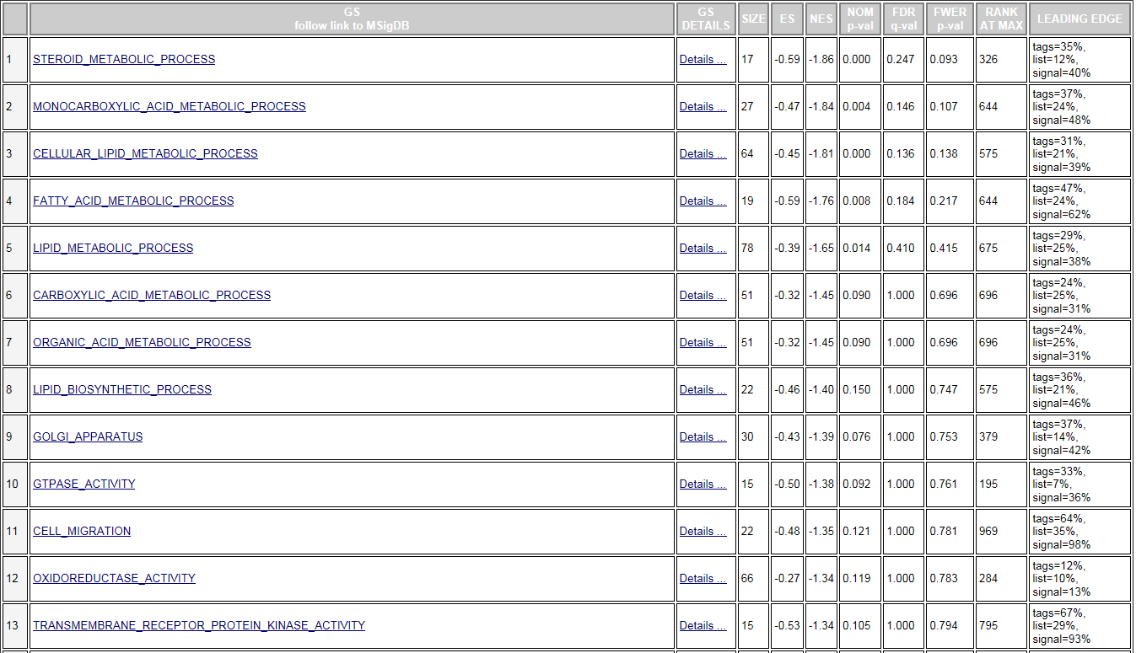

Slide 52
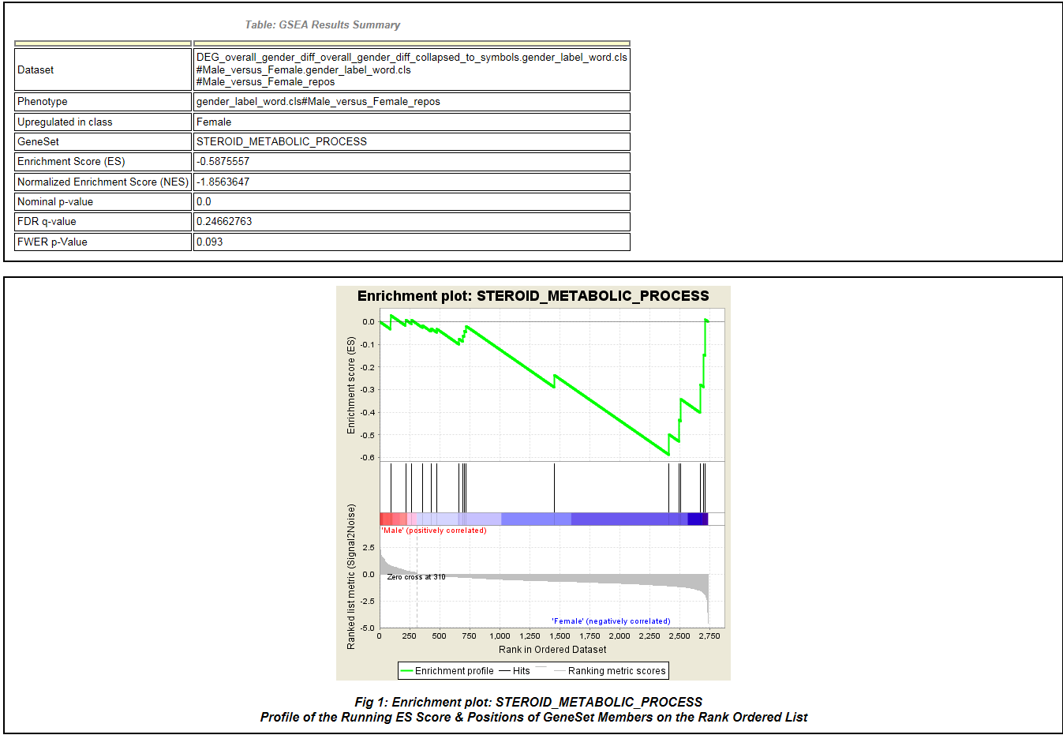
GSEA Example

Slide 53
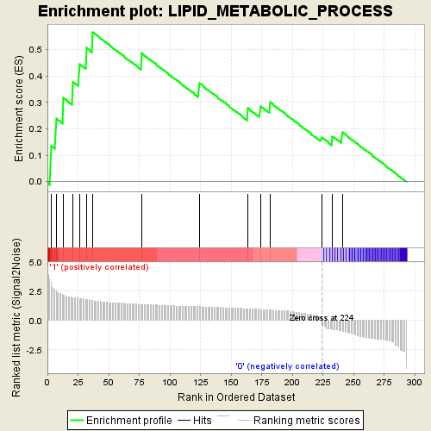
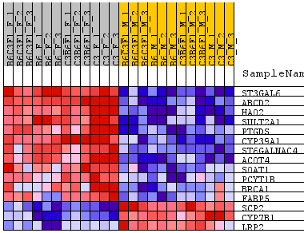
Lipid metabolism enriched -- GSEA

Slide 54
http://www-stat.stanford.edu/~tibs/GSA/
http://www.netsci.org/Resources/Software/Bioinform/pathwayanalysis.html
http://www.broadinstitute.org/gsea/index.jsp
http://david.abcc.ncifcrf.gov/
http://www.biocarta.com/
http://web.expasy.org/pathways/
http://www.genmapp.org/
http://www.genome.jp/kegg/
http://www.ingenuity.com/
http://www.genego.com/metacore.php
http://www.geneontology.org/
http://omicslab.genetics.ac.cn/GOEAST/tutorial.php
http://expressome.kobic.re.kr/GAzer/document.jsp
http://www.biobase-international.com/products
http://jaspar.genereg.net/

Slide 55
Additional slides

Slide 56
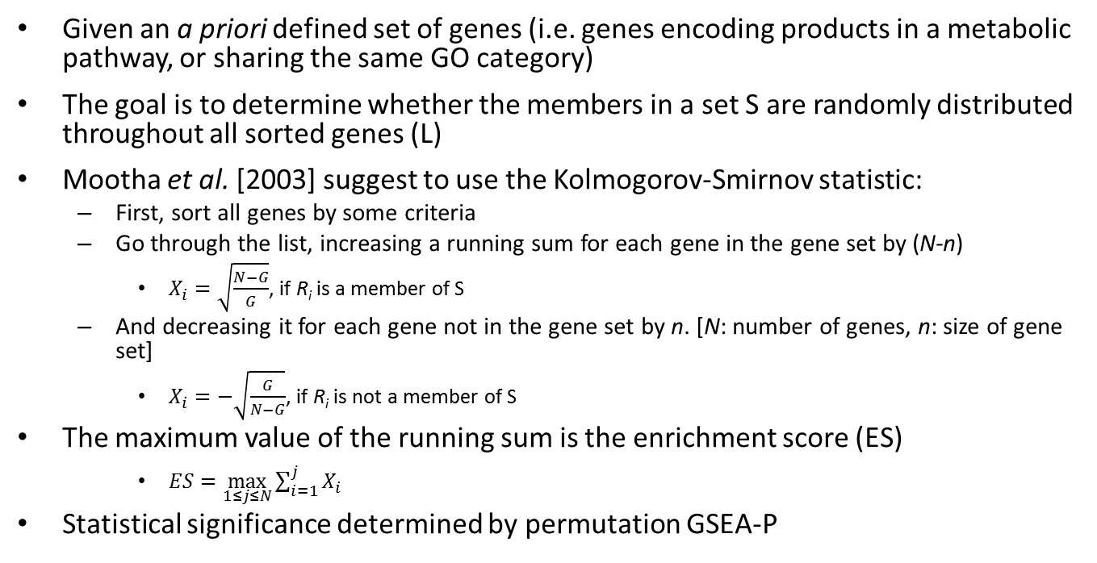
Gene set enrichment analysis (GSEA)
Given an a priori defined set of genes (i.e. genes encoding products in a metabolic pathway, or sharing the same GO category)
The goal is to determine whether the members in a set S are randomly distributed throughout all sorted genes (L)
Mootha et al. [2003] suggest to use the Kolmogorov-Smirnov statistic:
First, sort all genes by some criteria
Go through the list, increasing a running sum for each gene in the gene set by (N-n)
$X_{i}=\sqrt{\frac{N−G}{G}}$, if R_{i} is a member of S
And decreasing it for each gene not in the gene set by n. [N: number of genes, n: size of gene set]
$X_{i}=−\sqrt{\frac{G}{N−G}}$, if R_{i} is not a member of S
The maximum value of the running sum is the enrichment score (ES)
$ES=\max_{1≤j≤N}{\sum_{i=1}^{j}{X_{i}}}$
Statistical significance determined by permutation GSEA-P
Just FYI

Slide 57
Pathway analysis summary
Two major statistics approaches
Parametric vs. non-parametrics
Three major databases
Gene Ontology
KEGG
Transfac & transpath
A few popular applications
DAVID (free online)
GSEA (online and desktop java application)
GSA (R –package)
Ingenuity Pathway Analysis (licensed based)
Biobase/JASPER (license based)
GeneGO (license based)

Slide 58
A parametric approach
To associate the microRNA’s “expression” to their target genes
Hypergenometric distribution
All genes on the affymetrix array (total # of genes -- N)
Of which, some are “predicted” as microRNA targets (m) <-- a microRNA target set
DEG lists obtained from 17 contrasts (n)
Of which, k genes belong to this microRNA target set
In practice, a Fisher’s exact test was used
Hypergeometric distribution density
Hypergeometric test

Slide 59
Define your own “gene set” --miRs vs. their targets
Gene_A
Gene_B
Gene_C
Gene_D
Gene_E
Gene_F
Gene_G
Gene_H
Gene_I
…
miRs_001
miRs_002
miRs_003
miRs_004
…

Slide 60
Parametric approach summary
Statistics distribution based test (hyper geometric/FET)
And, there are a few violations (will be addressed shortly)
Knowledgebase used matters
Hands on practice on IPA

Slide 61
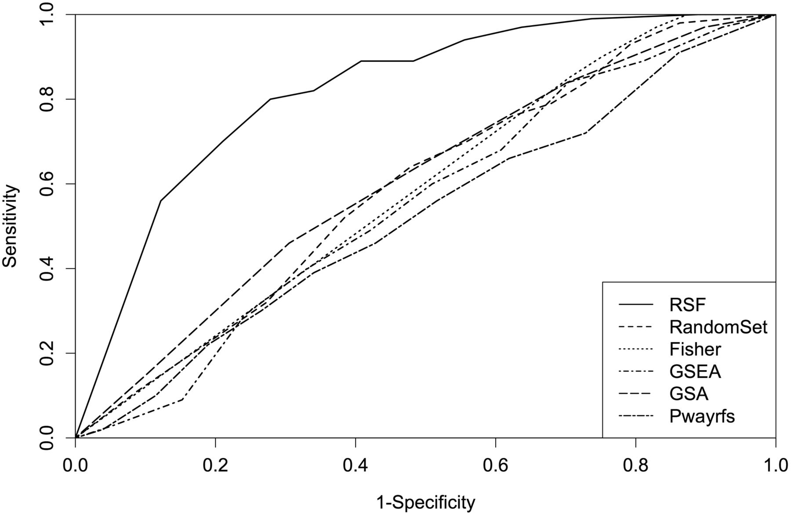
Comparison of performances of RSF, random-set, Fisher’s exact test, GSEA, GSA and Pwayrfsurvival using simulated expression data.
Chen X , and Ishwaran H Bioinformatics 2013;29:99-105
© The Author(s) 2012. Published by Oxford University Press. All rights reserved. For Permissions, please e-mail: journals.permissions@oup.com
Notes:
Comparison of performances of RSF, random-set, Fisher’s exact test, GSEA, GSA and Pwayrfsurvival using simulated expression data. This figure shows the ROC curves for simulation scenario 2 of Table 1

Slide 62
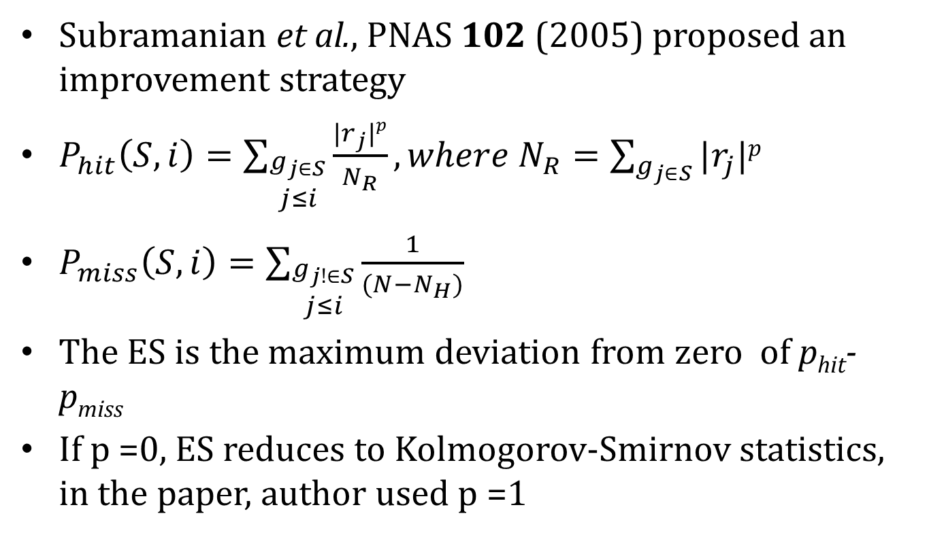
Improved KS statistics tests
Subramanian et al., PNAS 102 (2005) proposed an improvement strategy
$P_{hit}\left(S,i\right)=\sum_{\begin{aligned}g_{j∈S} \\ j≤i\end{aligned}}{\frac{|r_{j}|p}{N_{R}}},where N_{R}=\sum_{g_{j∈S}}{|r_{j}|p}$
$P_{miss}\left(S,i\right)=\sum_{\begin{aligned}g_{j!∈S} \\ j≤i\end{aligned}}{\frac{1}{(N−N_{H})}}$
The ES is the maximum deviation from zero of p_{hit}-p_{miss}
If p =0, ES reduces to Kolmogorov-Smirnov statistics, in the paper, author used p =1
Another FYI page

Slide 63
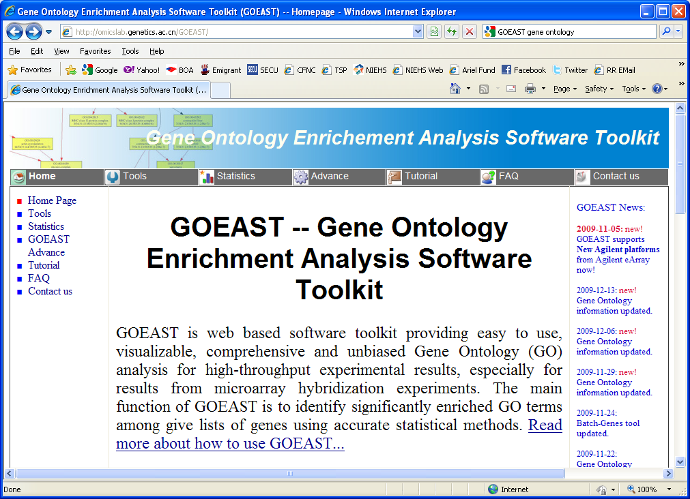
GOEAST – modification incorporated
Open web browser and navigate to: http://omicslab.genetics.ac.cn/GOEAST/
At the header tool bar, click on Tutorial
Notes:
63

